Slide 1


Open Text eDOCS DM 5.3
InnoKAT
Consultant
October 05, 2011
Rev 2.0 01102010

Slide 2
Agenda
Document Management Benefits
eDocs DM 5.3 Benefits
Benefits for Business Managers
Benefits for IT Administrators
Benefits for Information Workers
eDocs DM Features
eDocs DM Interfaces

Slide 3
Document Management Benefits
Notes:
Page 3

Slide 4












Unimpeded Content Flow
Corporate

Slide 5




Content in Action
People
Process
Content

Slide 6



































Full Information Governance with eDocs
Create & Capture
Collaborate & Manage
Integrate & Optimize
Experience
User Created
Review
Approve
Integrate
Localize
Search
Paper
E-Mail
E-Mail
Web
Collaborate
Integrate
Analyze
Graphics
Reports
Library
Portal
Audio
Video
Edit
Version
Integrate
Innovate
Print
Store & Manage
Search
Metadata Enrichment
Process
Archive
Retention
Disposition
Notes:
Content Lifecycle Management delivers an integrated set of ECM tools to support the five key stages of the life of content: Create & Capture; Collaborate & Manage; Integrate & Optimize; and Experience—underpinned by world class Retention & Storage Management.

Slide 7
eDocs DM 5.3 Benefits
Notes:
Page 7

Slide 8
What’s new for Business Managers
Ability to harvest collaborative knowledge.
Speed up time-to-decision.
Simplified access to business critical knowledge.
Improved organizational agility and to leverage an enhanced ability to generate competitive advantage from the organization’s cumulative knowledge.
Improved workforce productivity to securely manage and leverage content in context.
Centralized repository minimizes IT costs, helps ensure document currency and information access time.
Complete and integrated suite of enterprise content management solutions minimizes cost of ownership and maximizes the value of enterprise knowledge assets.

Slide 9
What’s new for IT Administrators
Ability to effectively and securely manage, organize and share documents.
Intuitive yet seamlessly blended document management tools with familiar content authoring and productivity tools.
Better control on document-based knowledge assets by enabling users to capture, organize, locate and share business content in a secure, integrated, and intuitive environment.
From documents, email, graphics, and forms to discussion threads, engineering drawings, scanned paper and electronic-based records, content is consolidated in a unified enterprise knowledge base for easy access and retrieval.
Features a scalable platform and distributed architecture designed to maximize system availability and performance.
Rapid system deployments and program updates are achieved without visiting workstations, and maintenance is simplified with Web and Microsoft® Windows® utilities that support centralized as well as delegated system management.
Enables Open Text eDOCS™ Suite integration as well as a range of companion solutions.

Slide 10
What’s new for Information workers
Reduced time and complexity associated with capturing, storing, organizing, and locating information, while at the same time ensuring the security and integrity of that information.
Better control over multiple document versions, enabling users to better organize documents, whether it be through the use of folder structures, tailored workspaces, or compound documents.
Seamless integration with standard applications & productivity tools used to create or capture content.
Familiar and intuitive browser-based and desktop interfaces (Windows Explorer and Microsoft® Outlook®-based interfaces) for power users.
Powerful search capabilities to quickly and easily locate information.

Slide 11
eDocs DM Features
Notes:
Page 11

Slide 12
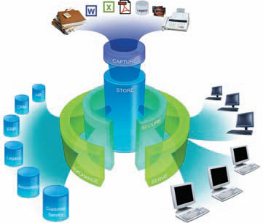
Open Text Document Management, eDOCS Edition (eDOCS DM 5.3)
Delivering enhanced application and platform support
Creating easy to deploy client and server-side installations
Broadening support for multiple file extensions
Creating seamless usage of the “Save User” Interface throughout
Supporting multiple communication protocols

Slide 13
eDocs DM Interfaces
Notes:
Page 13

Slide 14
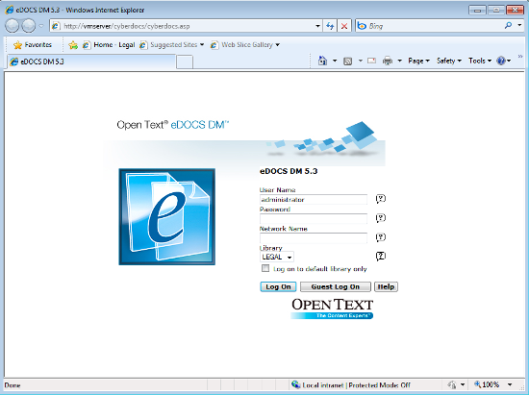

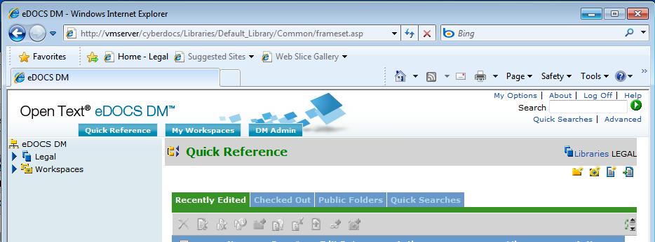
eDOCS DM 5.3 Webtop
Familiar and intuitive browser-based interface

Slide 15
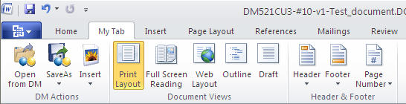
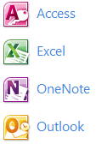
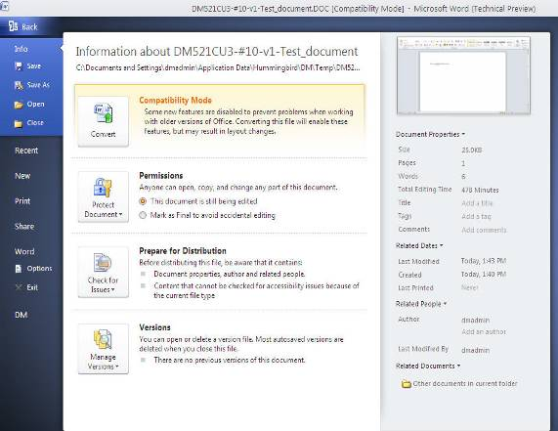
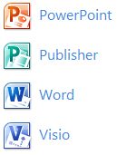
Microsoft Office 2010 Integration
New Integration designed from the “ground up”
Integration files independent of previous versions of Office
Movement from ODMA and COM add-ins for the previous releases to Microsoft’s VSTO only for this release
Integration into the Microsoft Backstage

Slide 16
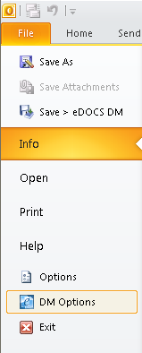
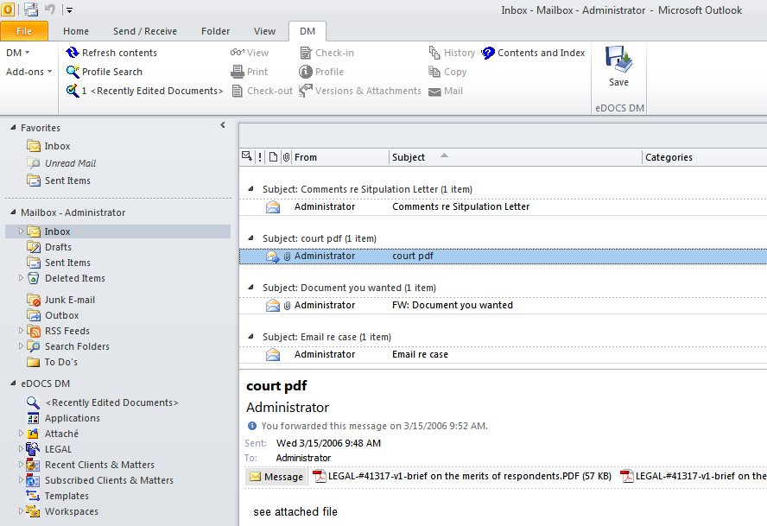

Microsoft Outlook 2010
eDOCS DM Commands are active when the eDOCS node is not selected
eDOCS DM node can be renamed
My eDOCS DM Project…
Integration with the Quick Access Toolbar and Custom Tabs

Slide 17





Updated Platform Support
Windows XP Professional
Windows Vista 32 bit
Windows 7 – 32 bit
Windows 7 – 64 bit
The DM Extensions will be a 32 bit application running on the 64 bit platform

Slide 18
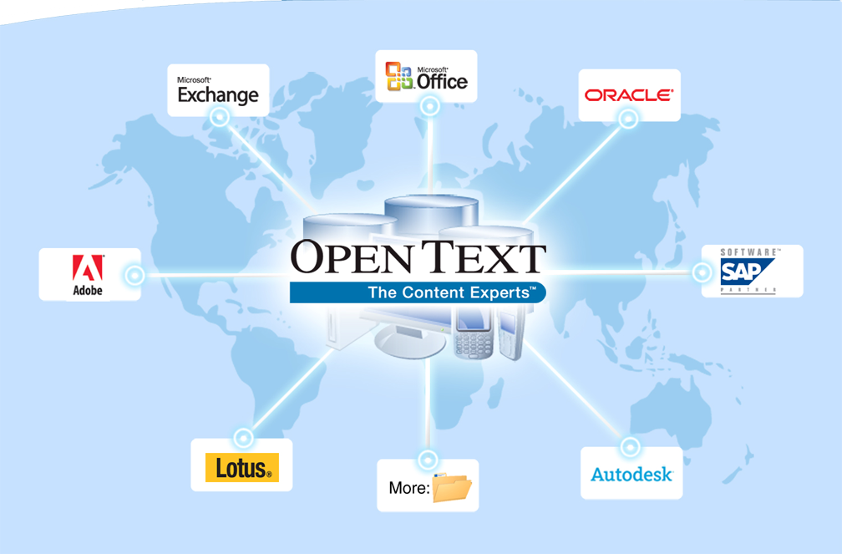
Trusted Management for Corporate Content
Notes:
Page 18
Page 18
Our solutions are based on capturing content in the native application, providing an un-intrusive experience for the end user. That content is brought together as an “Enterprise Library” or “content hub”, regardless of format and originating application, to be leveraged in an endless variety of business solutions needing to draw on content that spans those very originating applications.
Organizations like yours have several mission-critical applications: Microsoft Exchange email systems, Microsoft Office and SharePoint, Shared File Systems, one or more ERP and customer relationship management systems, legacy applications, and so on. Each of these applications creates a significant amount of unstructured content and stores it in its own manner - resulting in a number of content 'silos'.
Open Text provides you with a “content hub” … not a set of silos. We all understand that “silo effect”. This is how most enterprises operate today and I’m sure that you can identify with the challenges of “information silos”. Silos might typically be departmental, regional, divisional, or other organizational segments and result in numerous, often redundant systems and solutions. Content housed in each silo is hard to locate and in many cases near impossible to share with other “silos.”
What organizations need is a way to manage the flow of business content across silos and between various business systems – and that is where Open Text comes in…

Slide 19
Thank You

